Slide 1
www.undocumentedpatients.org
Undocumented Immigrants:
Access to Prenatal Care
Copyright © 2014 The Hastings Center

Slide 2
www.undocumentedpatients.org
Access to prenatal care for women who are undocumented immigrants varies widely across the United States due to differences in state policies and differing state level interpretations of federal policies that fund health services for pregnant women. This resource provides an overview of this access problem and the consequences of policy related uncertainty or variation for undocumented patients, their families, and the health care safety-net.
For additional resources and state-by-state references on this topic, visit: http://www.undocumentedpatients.org/issuebrief/undocumented-immigrants-in-the-united-states-access-to-prenatal-care/.

Slide 3
Why is access to prenatal care for undocumented immigrants important?
www.undocumentedpatients.org
Prenatal care is fundamental to women’s reproductive health and to infant health.
Undocumented immigrants in the U.S. are less likely to have adequate prenatal care, compared to other immigrants and U.S. born citizens. The reasons for this gap include a lack of means to pay for prenatal care, lack of access to sources of prenatal care, and mistrust of the health care system [1-4]. Other barriers that undocumented immigrants face when seeking health care include:
Difficulty navigating safety-net health care systems
Language and literacy
Inability to take time off from work
Misinformation about the immigration related consequences of using health care services
Perceived and actual risks of encountering immigration authorities or local law enforcement [5]

Slide 4
Lack of access to prenatal care: health consequences for undocumented women and their children
www.undocumentedpatients.org
Lack of access to prenatal care increases the risk of premature birth and low birth weight, and may be a factor in a range of poor health outcomes experienced by
undocumented pregnant women and their babies, including higher rates of labor and delivery complications such as: precipitous labor, excessive bleeding, breech
presentation, cord prolapse, and fetal distress. [9-10]
These risks and outcomes have consequences for:
the viability and health of newborns
infant and child development
the health of mothers
costs associated with treating medical conditions that could have been prevented or detected and managed before birth

Slide 5
The Emergency Medical Treatment and Active Labor Act (EMTALA)
www.undocumentedpatients.org
EMTALA prevents hospitals from turning away uninsured patients in need of emergency treatment.
EMTALA encompasses labor and delivery. Most “emergency” health are services used by undocumented immigrants are related to childbirth.
State-level emergency Medicaid programs provide some reimbursement to hospitals for treatment provided under EMTALA [6-8]. Undocumented immigrants may account for 99% of Emergency Medicaid expenditures in some states; approximately 80% of these costs relate to childbirth or to complications in pregnancy and labor.
EMTALA is designed for emergent conditions. It is not a mechanism for access to routine prenatal care that could prevent or monitor pregnancy-related complications [8].

Slide 6
www.undocumentedpatients.org
State and local policy provisions covering prenatal care for undocumented immigrants
Most states provide some access to prenatal care for undocumented immigrants through state funded policy mechanisms such as Medicaid.
Some states explicitly exclude undocumented immigrants from coverage for prenatal care. The scope of services and length of coverage for prenatal care varies from state to state; local level provisions also vary.
Health care professionals should know current policy concerning access to prenatal care in the state where they practice. In their role as advocates, they should also be aware of policy mechanisms used in other states that could potentially expand access to care in their state.

Slide 7
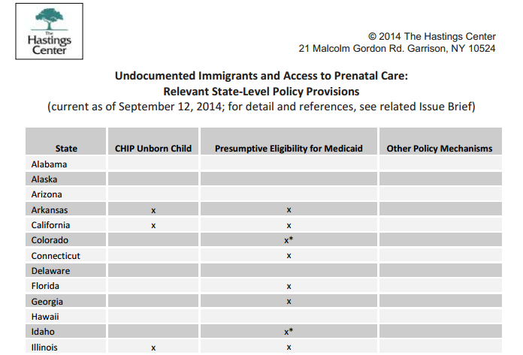
CHIP Unborn Child Option
www.undocumentedpatients.org
As of September 2014, 16 states had implemented a State Plan Amendment (SPA) to the Children’s Health Insurance Program (CHIP), which is jointly supported by federal and state funds. An unborn child may be considered a “target low-income child” who is eligible for this program.
This provision would enable an undocumented immigrant to enroll her unborn child in the program so she can obtain coverage for prenatal care and labor and delivery services [11].
Under this provision, pregnancy-related services such as prenatal vitamins and ultrasounds may be covered but services perceived as unrelated to pregnancy may not be covered.
For state-by-state detail, see chart: http://www.undocumentedpatients.org/wp-content/uploads/2014/09/Access-to-Prenatal-Care-Chart.pdf

Slide 8
Presumptive Eligibility for Medicaid (PE)
Presumptive eligibility (PE) is a state-level mechanism that enables pregnant women to obtain immediate temporary Medicaid coverage without having to wait for a Medicaid application to be processed. As of September 2014, PE was available in 30 states, 13 of which explicitly restrict access to women with legal immigration status.
Physicians who are “qualified providers” of Medicaid services and eligible to determine PE based on a patient’s self-reported income can provide Medicaid-funded care to any pregnant woman whose self-reported income meets that state’s eligibility threshold.
During the time-limited PE period, women are expected but not required to submit an application for regular Medicaid coverage. PE coverage typically lasts two months, or until a decision approving the applicant for Medicaid is made.
The scope of services covered under PE differs by state; some states cover only ambulatory prenatal care, while others cover the full Medicaid scope of services.
For state-by-state detail, see chart: http://www.undocumentedpatients.org/wp-content/uploads/2014/09/Access-to-Prenatal-Care-Chart.pdf

Slide 9
Other state-level policy mechanisms
www.undocumentedpatients.org
Expanding eligibility for safety-net health insurance programs to include coverage for low-income pregnant women regardless of immigration status is another way that some states provide coverage for prenatal care to undocumented immigrants: Three states – New York, New Jersey, and Massachusetts – offer public insurance for the duration of pregnancy and for two months after delivery:
In New York, this coverage is offered as an entitlement program through a state-funded Medicaid expansion, supplemented by the CHIP Unborn Child Option to cover ambulatory prenatal care services.
In New Jersey, Medicaid coverage for prenatal care only is funded through the state budget and offered through community health centers and hospitals subject to the availability of grant funds.
In Massachusetts, coverage is provided through a state-funded Medicaid expansion, supplemented by the CHIP Unborn Child Option to cover ambulatory prenatal care services.
For state-by-state detail, see chart: http://www.undocumentedpatients.org/wp-content/uploads/2014/09/Access-to-Prenatal-Care-Chart.pdf

Slide 10
Local policy mechanisms
www.undocumentedpatients.org
In some cities, undocumented immigrants are eligible for coverage for prenatal care and other health care services through locally-funded programs. In Washington D.C, for example, the D.C. Healthcare Alliance provides insurance coverage for low-income city residents who do not have Medicaid or other insurance.
Beyond publicly-funded insurance mechanisms, access to prenatal care for undocumented immigrants may also be provided directly by public health clinics and nonprofit organizations (such as Federally Qualified Health Centers) that offer health services for patients without insurance. These services may be available for free, or at sliding-scale fee based on a patient’s ability to pay.

Slide 11
References
www.undocumentedpatients.org
1. Amer­i­can Acad­emy of Pedi­atrics, Guide­lines for Peri­na­tal Care, 7th ed. 2012.
2. ACOG Com­mit­tee Opin­ion No. 425: health care for undoc­u­mented immi­grants. Obstet Gynecol, 2009. 113(1): 251–4.
3. Cohen, G.J., The pre­na­tal visit. Pedi­atrics, 2009. 124(4): 1227–32.
4. Korinek, K. and K.R. Smith, Pre­na­tal care among immi­grant and racial-ethnic minor­ity women in a new immi­grant des­ti­na­tion: explor­ing the impact of immi­grant legal sta­tus. Soc Sci Med, 2011. 72(10): 1695–703.
5. Fris­bie, W.P., S. Echevar­ria, and R.A. Hum­mer, Pre­na­tal care uti­liza­tion among non-Hispanic Whites, African Amer­i­cans, and
Mex­i­can Americans. Matern Child Health J, 2001. 5(1): 21–33.
6. Fed­eral Fund­ing for Unau­tho­rized Aliens’ Emer­gency Med­ical Expenses, in CRS Report For Con­gress. 2004.
7. United States Con­gres­sional Bud­get Office, The Impact of Unau­tho­rized Immi­grants on the Bud­gets of State and Local
Gov­ern­ments. 2007.
8. DuBard, C.A. and M.W. Mass­ing, Trends in emer­gency Med­ic­aid expen­di­tures for recent and undoc­u­mented immi­grants. JAMA, 2007. 297(10):1085–92.
9. Lu, M.C., et al., Elim­i­na­tion of pub­lic fund­ing of pre­na­tal care for undoc­u­mented immi­grants in Cal­i­for­nia: a cost/benefit analy­sis. Am J Obstet Gynecol, 2000. 182 (1 Pt 1): 233–9.
10. Reed, M.M., et al., Birth out­comes in Colorado’s undoc­u­mented immi­grant pop­u­la­tion. BMC Pub­lic Health, 2005. 5: 100.
11. State Children’s Health Insur­ance Pro­gram; Elig­ility for Pre­na­tal Care and Other Health Ser­vices for Unborn Chil­dren, F.
Reg­is­ter, Edi­tor. 2002: 61956–61974.

Slide 12
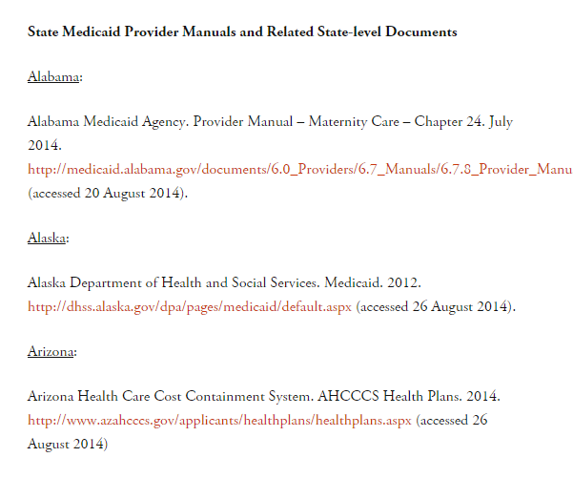
Web-based resources
www.undocumentedpatients.org
On immigrants’ eligibility for public benefits, including Medicaid and CHIP, see Overview of Immigrants’ Eligibility for SNAP, TANF, Medicaid, and CHIP, Office of the Assistant Secretary for Planning and Evaluation (March 2012): http://aspe.hhs.gov/hsp/11/ImmigrantAccess/Eligibility/ib.shtml.
For Medicaid Provider Manuals and related documents for all 50 states, see: http://www.undocumentedpatients.org/issuebrief/undocumented-immigrants-in-the-united-states-access-to-prenatal-care/.
For Kaiser Family Foundation list of states with Presumptive Eligibility as of January 2013, see: http://kff.org/medicaid/state-indicator/presumptive-eligibility/.

Slide 13
Web-based resources
www.undocumentedpatients.org
On access to prenatal care in the context of ACA implementation, see: “Get­ting into Gear for 2014: Find­ings from a 50-State Sur­vey of Eli­gi­bil­ity, Enrollment, Renewal, and Cost-Sharing Poli­cies in Med­ic­aid and CHIP, 2012–2013,” Kaiser Com­mis­sion on Med­ic­aid and the Unin­sured (Jan­u­ary 2013): http://kaiserfamilyfoundation.files.wordpress.com/2013/05/8401.pdf
On Medicaid Pre­sump­tive Eli­gi­bil­ity in the context of ACA implementation, see: “Imple­men­ta­tion of the Afford­able Care Act’s Hos­pi­tal Pre­sump­tive Eli­gi­bil­ity Option: Con­sid­er­a­tions for States,” Cen­ter for Medicare and Med­ic­aid Ser­vices (Novem­ber 2013): http://www.medicaid.gov/State-Resource-Center/MAC-Learning-Collaboratives/Learning-Collaborative-State-Toolbox/Downloads/State-Network-CHCS-Implementation-of-the-Affordable-Care-Acts-Hospital-P.pdf; see also: “The New Hos­pi­tal Pre­sump­tive Eli­gi­bil­ity Oppor­tu­nity,” Enroll Amer­ica (March 2014): http://www.enrollamerica.org/toolkits/pe/home.html

Slide 14
www.undocumentedpatients.org
This resource from the Undocumented Patients Project of The Hastings Center was edited by Nancy Berlinger and designed by Chelsea Jack based on the September 2014 issue brief “Undocumented Immigrants in the United States: Access to Prenatal Care.”
The issue brief was drafted by Rachel Fabi with research assis­tance from Mohini Baner­jee, edited by Michael K. Gus­mano and Nancy Berlinger, and designed by Mohini Baner­jee. Evan A. Ashkin, MD, Asso­ciate Pro­fes­sor of Fam­ily Med­i­cine, Uni­ver­sity of North Car­olina at Chapel Hill; Kate Bicego, Con­sumer Assis­tance Pro­gram Man­ager, Health Care For All, Boston, MA; Car­o­line Rath, physi­cian assis­tant, Gou­verneur Health­care Ser­vices, New York City; and Eva Tur­biner, Pres­i­dent and CEO, Zufall Health Cen­ter, Dover, NJ served as expert reviewers.
For the issue brief and further resources, see: http://www.undocumentedpatients.org/issuebrief/undocumented-immigrants-in-the-united-states-access-to-prenatal-care/.
Infor­ma­tion about pol­icy mech­a­nisms was com­piled using pub­licly avail­able docu­ments, includ­ing Med­ic­aid Provider Man­u­als for each state; see Ref­er­ences. All infor­ma­tion is cur­rent as of Sep­tem­ber 12, 2014.

